Slide 1

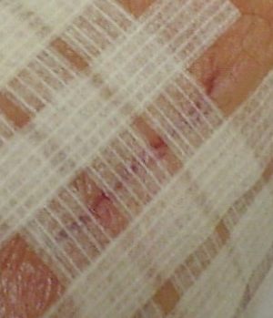
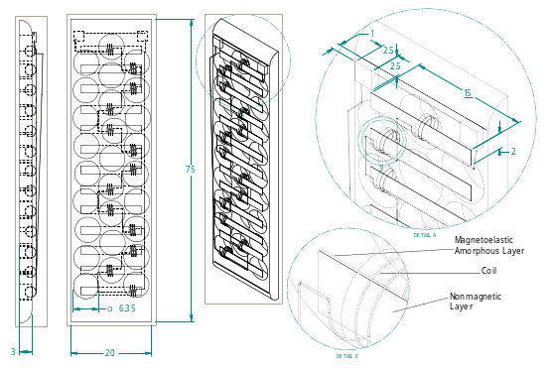
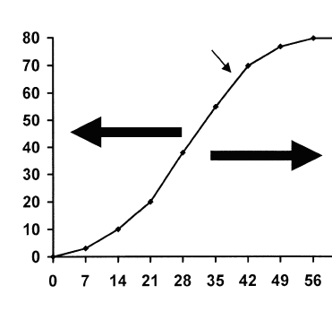

Magnetostrictive Wound Monitoring Support Layer
BMED 4600. Senior Design I. Spring Semester 2008
Primary Author: Sean Lynch; Team Members: Sochetra Kong, Christopher Lacey, Vanessa Yip
Project Brief
Proposed Design
Discussion
Nearly 50 million surgical procedures are performed in the U.S. each year.¹ An expensive and major complication during healing is wound dehiscence, occurring in 3% of patients. A device that monitors wound healing in acute wounds up to 5cm in length¹ by
Design approach uses a magnetostrictive bilayer film to sense changes in stress across an adhesively bound wound closure support layer.
Amorphous magnetostrictive top layer senses stress across the support layer while the non-magnetic bottom counter layer increases sensitivity.
Tensile force data feeds into a microprocessor and sensor outside of the body, where there is little constraint on the size of these instruments.
Tapes are up to 30μm thick, comfortably fitting along a wound’s edges.
No previous patents using the Villari effect and Faraday’s law have been made for force measurement of a support layer used in wound closure.
Adaptation of previously patented films and biosensors for force measurement will be made so that a tension monitoring system integrates well with a wound closure support layer like Steri-StripsTM.
The computer vision approach was rejected because the software and hardware required far exceeds the allocated budget and is difficult to use
Capacitive pressure sensors were rejected because of intellectual property constraints & difficulty in modifying a vacuum tight cavity
The proposed design satisfies design specifications. Prior art, such as the magnetostrictive bilayer sensor non-invasively measuring blood pressure through its bilayer deflection when placed over the carotid artery³, is evidence of a highly sensitive application of the sensor
An adaptive design approach using similar concepts is plausible and sensitive enough to monitor tension across a wound closure support layer
The design concept chosen is compatible with Steri-StripsTM
This approach has high patentability as it is innovative in its use
measuring tensile stress across a wound’s edges is needed. The device will consist of a grid of magnetostrictive bilayer sensors measuring tensile stress via the Villari effect & Faraday’s law while adhesively attached to a support layer of biocompatible adhesive tape such as Steri-StripsTM.
Design Research Methodologies
Literature search of wound healing and tension biosensors via online databases: PubMed, Google Scholar, Google Books, and IEEE
Searched Google Patent and United States Patent Office for Prior Art
List of 57 key terms like magnetostrictive bilayer tension biosensors
Alternative design concepts of prior art from literature were compared to criteria from the engineering design specifications
Conclusion
The purpose of this project was to design a device that would have the ability to measure tensile stress across wound closure devices
After weighing design alternatives against engineering design specification criteria & conducting a prior art and literature search, the final design proposes to uses a grid of magnetostrictive bilayer film based sensors to detect tensile stress across a support layer
Force data will feed into a microprocessor and sensor outside of the body, where there is little constraint on the size of these instruments⁴
The device will incorporate, Steri-StripsTM , a FDA approved support layer while also being compatible with DERMABOND topical adhesive
Engineering Design Specifications
I. Expected Functional Parameters & Engineering Characteristics
  Selected design approach records tensile stress while placed along acute wound up to 5 cm long & normal to longest direction of laceration
  If maximum tension across the support layer is breached or the rate of tensile force reduction abnormal, the device will alert the patient
Nonmagnetic Layer
II. Human factors and considerations
  Limited to placement over clean edged, superficial wounds occurring in non-flexible and non-elastic skin areas
  Maximum weight for a 5 cm by 2 cm wound closure system is no more than 20g to prevent sliding⁴
  Device needs to employ biocompatible biomaterials with no leachable, toxic by-products or degradation.
% Breaking Strength of Unwounded Tissue
Normal Healing
Gold Coil
Project Plan
Magnetoelastic Amorphous Layer
The second semester work on this project, spanning August-December 2008, will seek to build and test an effective prototype of the proposed design. The important milestones are listed:
August 30, 2008: Order parts to build prototype using allotted budget
September 17, 2008: Societal Impact Report
October 15, 2008: Regulatory Report
November 17, 2008: Final Prototype
December 3, 2008: Complete final presentation and report on project
Ideal Healing
Figure 1: Solid edge model illustrating a grid of magnetostrictive bilayer films adhesively bound to a porous wound closure support layer. Bilayer films are surrounded by gold coils connected in series sensing changes in induction. Distances shown above are in millimeters (mm).
Impaired Healing
Design Alternatives
III. Metrics for customer satisfaction
  Measuring tensile stress, ergonomics, size, material properties, biocompatibility, education, ethics & standards (ASTM, ISO & FDA)
IV. Constraints
  End product transmits force data via radiofrequency technology to be processed at a computer outside the body
  Compatible with FDA approved adhesive support layer & topical adhesive
1. Measure forces across a wound closure support layer using microscope optics and cameras as well as equations of elasticity and a deformable matching algorithm. A computer program is used to recognize the proper deformation and measures the tension that the layer is under.
2. Capacitive pressure microsensor is used. This equivalent parallel plate capacitor is formed between a thin layer of silicon and a fixed electrode plate with a hermetically sealed cavity between them. This diaphragm is the main pressure sensing device, leading to the detection of tension.
References
Days
Google Scholar, Google Patent, United States Patent and Trademark Office
[1] Hoath, Steven B., Donnelly MM, and Raymond BE. Sensory Transduction and the Mammalian Epidermis. Biosens Bioelectron. 1990; 5:351-366.
[2] Malowaniec K.D. and Heidenheim D.E.. U.S. Patent 6 242 665, 1999.
[3] Kaniusas E, Pfutzner H, Mehnen L et al. Magnetoelastic Skin Curvature Sensor for Biomedical Applications. IEEE. 2004;1484-1487.
[4] Mehnen L., Pfutzner H., Kaniusas E. Magnetostrictive Amorphous Bimetal Sensors. Journal of Magnetism and Magnetic Materials. 2000;215-216:779-781.

